Slide 1
Chapter 2
E-Commerce: Mechanisms, Infrastructures, and Tools

Slide 2
Learning Objectives
Describe the major electronic commerce (EC) activities and processes and the mechanisms that support them.
Define e-marketplaces and list their components.
List the major types of e-marketplaces and describe their features.
Describe electronic catalogs, search engines, and shopping carts.
Describe the major types of auctions and list their characteristics.

Slide 3
Learning Objectives
Discuss the benefits and limitations of e-auctions.
Describe bartering and negotiating online.
Describe virtual communities.
List the major Web 2.0 tools and their use in EC.
Describe social networks as an EC mechanism.
Understand virtual worlds and their use in EC.
Describe Web 3.0 and define Web 4.0.

Slide 4
Electronic Commerce Mechanisms: An Overview
EC ACTIVITIES AND SUPPORT MECHANISMS
SELLERS, BUYERS, AND TRANSACTIONS
The Purchasing Process

Slide 5
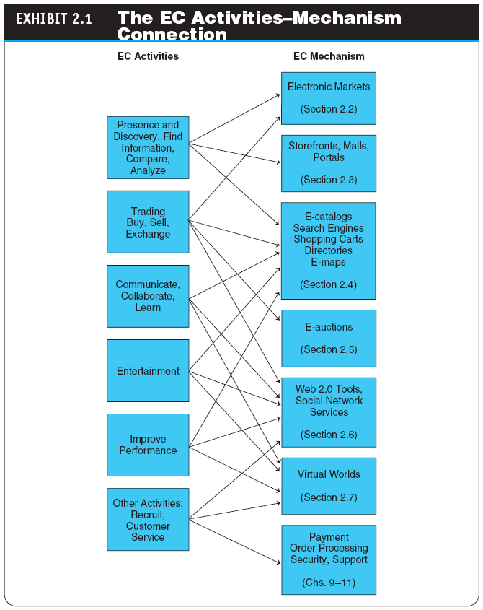

Slide 6
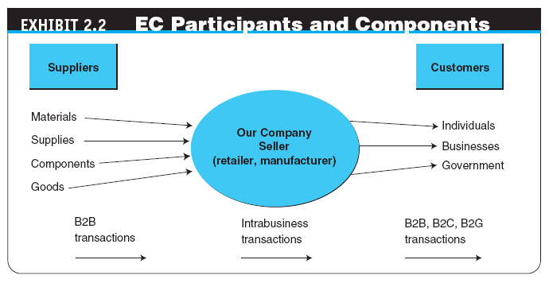

Slide 7
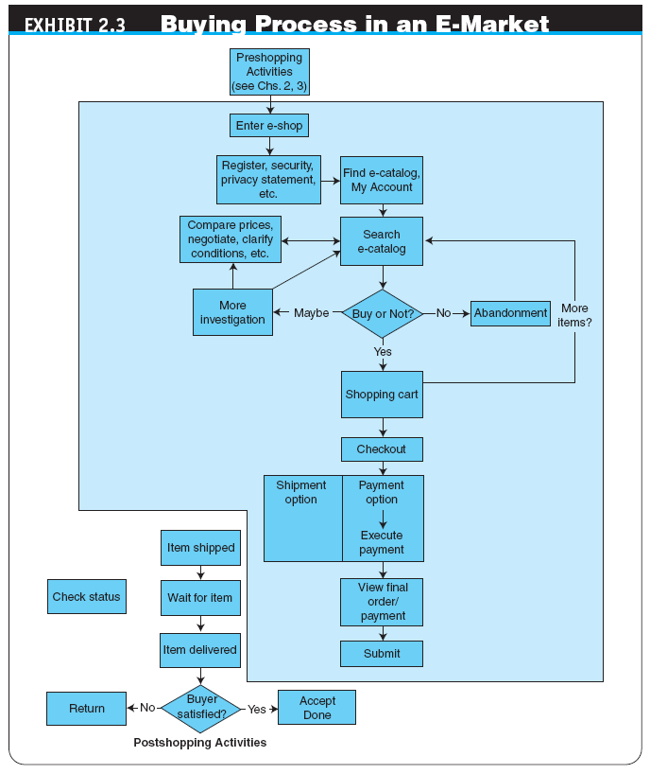

Slide 8
E-Marketplaces
e-marketplace
An online market, usually B2B, in which buyers and sellers exchange goods or services; the three types of e-marketplaces are private, public, and consortia
COMPONENTS OF AND THE PARTICIPANTS IN E-MARKETPLACES
marketspace
A marketplace in which sellers and buyers exchange goods and services for money (or for other goods and services), but do so electronically

Slide 9
E-Marketplaces
The major components and players in a marketspace are:
Customers
Sellers
Products and services
digital products
Goods that can be transformed to digital format and delivered over the Internet
Infrastructure

Slide 10
E-Marketplaces
front end
The portion of an e-seller’s business processes through which customers interact, including the seller’s portal, electronic catalogs, a shopping cart, a search engine, and a payment gateway
back end
The activities that support online order fulfillment, inventory management, purchasing from suppliers, payment processing, packaging, and delivery
intermediary
A third party that operates between sellers and buyers

Slide 11
E-Marketplaces
DISINTERMEDIATION AND REINTERMEDIATION
disintermediation
Elimination of intermediaries between sellers and buyers

Slide 12
E-Marketplaces
TYPES OF E-MARKETPLACES
sell-side e-marketplace
A private e-marketplace in which one company sells either standard and/or customized products to qualified companies
buy-side e-marketplace
A private e-marketplace in which one company makes purchases from invited suppliers

Slide 13
Customer Shopping Mechanisms: Storefronts, Malls, and Portals
Webstore (storefront)
A single company’s website where products or services are sold; usually has an online shopping cart associated with it
Many Webstores target a specific industry and find their own unique corner of the market.
Microsites

Slide 14
Customer Shopping Mechanisms: Storefronts, Malls, and Portals
e-mall (online mall)
An online shopping center where many online stores are located
TYPES OF STORES AND MALLS
General stores/malls
Specialized stores/malls
Regional versus global stores
Pure-play versus click-and-mortar stores

Slide 15
Customer Shopping Mechanisms: Storefronts, Malls, and Portals
Web (information) portal
A single point of access, through a Web browser, to critical business information located inside and outside (via Internet) an organization
Types of Portals
Commercial (public) portals
Corporate portals
Publishing portals
Personal portals
mobile portal
A portal accessible via a mobile device.
voice portal
A portal accessed by telephone or cell phone.

Slide 16
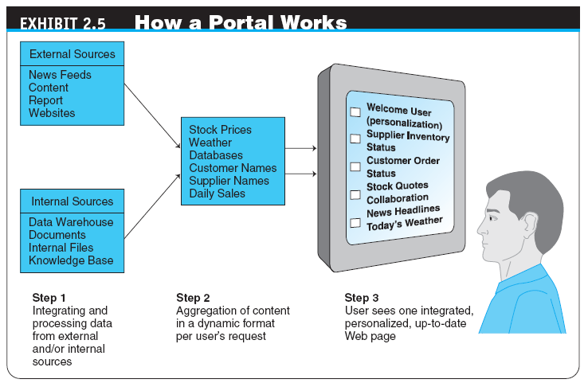

Slide 17
Customer Shopping Mechanisms: Storefronts, Malls, and Portals
THE ROLES AND VALUE OF INTERMEDIARIES IN E-MARKETPLACES
Brokers
infomediaries
Electronic intermediaries that provide and/or control information flow in cyberspace, often aggregating information and selling it to others
e-distributor
An e-commerce intermediary that connects manufacturers with business buyers (customers) by aggregating the catalogs of many manufacturers in one place—the intermediary’s website
Notes:
Stop slot 1, slot 4

Slide 18
Merchant Solutions: Electronic Catalogs, Search Engines, and Shopping Carts
electronic catalogs (e-catalogs)
The presentation of product information in an electronic form; the backbone of most e-selling sites
Online Catalogs Versus Paper Catalogs

Slide 19
Merchant Solutions: Electronic Catalogs, Search Engines, and Shopping Carts
EC SEARCH ACTIVITIES, TYPES, AND ENGINES
Types of EC Searches
Internet/Web Search
enterprise search
The practice of identifying and enabling specific content across the enterprise to be indexed, searched, and displayed to authorized users

Slide 20
Merchant Solutions: Electronic Catalogs, Search Engines, and Shopping Carts
desktop search
Search tools that search the contents of a user’s or organization’s computer files, rather than searching the Internet
The emphasis is on finding all the information that is available on the user’s PC, including Web browser histories, e-mail archives, and word-processed documents, as well as in all internal files and databases.

Slide 21
Merchant Solutions: Electronic Catalogs, Search Engines, and Shopping Carts
search engine
A computer program that can access databases of Internet resources, search for specific information or key words, and report the results
Software (Intelligent) Agents
Questions and Answers Online
Voice-Powered Search
Visual Shopping Search Engine

Slide 22
Merchant Solutions: Electronic Catalogs, Search Engines, and Shopping Carts
electronic shopping cart
An order-processing technology that allows customers to accumulate items they wish to buy while they continue to shop
OTHER MECHANISMS IN MERCHANT SOFTWARE
Other Shopping Engines
Product Configuration

Slide 23
Auctions, Bartering, and Negotiating Online
auction
A competitive process in which a seller solicits consecutive bids from buyers (forward auctions) or a buyer solicits bids from sellers (backward auctions); prices are determined dynamically by the bids
dynamic pricing
Prices that change based on supply and demand relationships at any given time
Notes:
stop

Slide 24
Auctions, Bartering, and Negotiating Online
TRADITIONAL AUCTIONS VERSUS E-AUCTIONS
Limitations of Traditional Offline Auctions
electronic auctions (e-auctions)
Auctions conducted online
INNOVATIVE AUCTIONS

Slide 25
Auctions, Bartering, and Negotiating Online
TYPES OF AUCTIONS
One Buyer, One Seller
One Seller, Many Potential Buyers
forward auction
An auction in which a seller entertains bids from buyers; bidders increase price sequentially

Slide 26
Auctions, Bartering, and Negotiating Online
One Buyer, Many Potential Sellers
reverse auction (bidding or tendering system)
Auction in which the buyer places an item for bid (tender) on a request for quote (RFQ) system, potential suppliers bid on the job, with the price reducing sequentially, and the lowest bid wins; primarily a B2B or G2B mechanism
name-your-own-price model
Auction model in which a would-be buyer specifies the price (and other terms) he or she is willing to pay to any willing and able seller; a C2B model that was pioneered by Priceline.com.

Slide 27
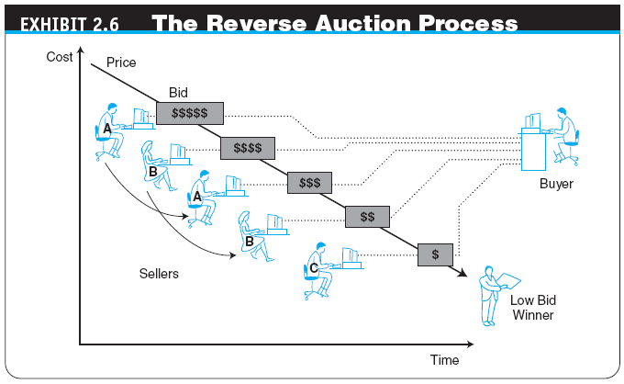

Slide 28
Auctions, Bartering, and Negotiating Online
Many Sellers, Many Buyers
double auction
An auction in which multiple buyers and their bidding prices are matched with multiple sellers and their asking prices, considering the quantities on both sides
penny auction
A formal auction in which participants pay a nonrefundable small fee for each bid; bid level changes by small increments

Slide 29
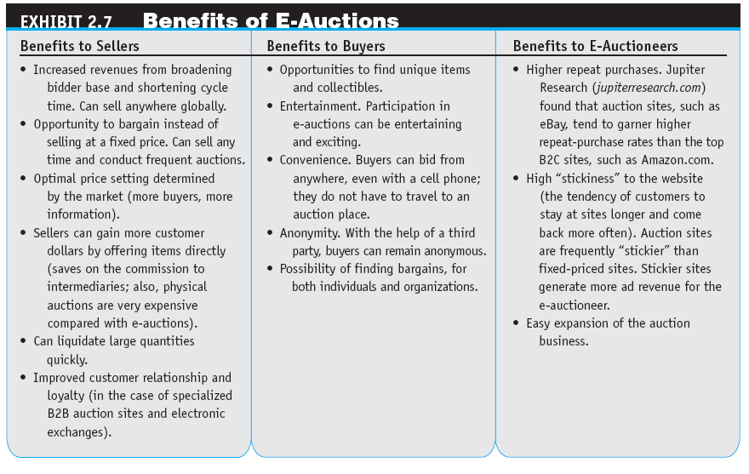

Slide 30
Auctions, Bartering, and Negotiating Online
Limitations of E-Auctions
Minimal Security
Possibility of Fraud
Limited Participation

Slide 31
Auctions, Bartering, and Negotiating Online
IMPACTS OF AUCTIONS
Auctions as a Social Mechanism to Determine a Price
Auctions as a Highly Visible Distribution Mechanism
Auctions as an EC Component in a Business Model
Auctions for Profit for Individuals

Slide 32
Auctions, Bartering, and Negotiating Online
ONLINE BARTERING
bartering
The exchange of goods and services
e-bartering (electronic bartering)
Bartering conducted online, usually in a bartering exchange
bartering exchange
A marketplace in which an intermediary arranges barter transactions
ONLINE NEGOTIATING

Slide 33
Social Software Tools: From Blogs to Wikis to Twitter
social software
A software product that enables people to rendezvous, connect, and collaborate through computer-mediated communication
blog
A personal website that is open to the public to read and to interact with; dedicated to specific topics or issues
vlog (or video blog)
A blog with video content

Slide 34
Social Software Tools: From Blogs to Wikis to Twitter
Building Effective Blogs
Commercial Uses of Blogs
Potential Risks of Corporate Blogs
microblogging
A form of blogging that allows users to write messages (usually up to 140 characters) and publish them, either to be viewed by anyone or by a restricted group that can be chosen by the user; these messages can be submitted by a variety of means, including text messaging, instant messaging, e-mail, MP3, or just on the Web

Slide 35
Social Software Tools: From Blogs to Wikis to Twitter
Twitter
A free microblogging service that allows its users to send and read other users’ updates
tweets
Text-based posts up to 140 characters in length posted to Twitter
The Essentials of Twitter for Business
The Major Benefits of Twitter
Examples of Twitter as Enterprise Tools

Slide 36
Social Software Tools: From Blogs to Wikis to Twitter
wiki (wikilog)
A blog that allows everyone to participate as a peer; anyone may add, delete, or change content
Business Applications of Wikis

Slide 37
Social Software Tools: From Blogs to Wikis to Twitter
MECHANISM AIDS FOR WEB 2.0 TOOLS: TAGS, FOLKSONOMY, MASHUPS, AND SOCIAL BOOKMARKS
tag
A nonhierarchical key word or term assigned to a piece of information (such as an Internet bookmark, digital image, video clip, or any computer document)
folksonomy (collaborative tagging, social tagging)
The practice and method of collaboratively creating, classifying, and managing tags to annotate and categorize content

Slide 38
Social Software Tools: From Blogs to Wikis to Twitter
mashup
Combination of two or more websites into a single website that provides the content of both sites (whole or partial) to deliver a novel product to consumers
social bookmarking
Web service for sharing Internet bookmarks; the sites are a popular way to store, classify, share, and search links through the practice of folksonomy techniques on the Internet and intranets

Slide 39
Virtual Communities and Social Networks
virtual community
A group of people with similar interests who interact with one another using the Internet

Slide 40
Virtual Communities and Social Networks
CHARACTERISTICS OF TRADITIONAL ONLINE COMMUNITIES AND THEIR CLASSIFICATION
Types of Communities
Associations
Affinity portals
Ethnic communities
Gender communities
Catering to young people
Communities of practice
Neighborhood communities
Social networks sites
Virtual worlds

Slide 41
Virtual Communities and Social Networks
Other Classifications of Virtual Communities
Public Versus Private Communities
Classification Categories
ONLINE SOCIAL NETWORKS
A Definition and Basic Information
The Size of Social Network Sites
A Global Phenomenon
Representative Capabilities and Services Provided by Social Network Sites

Slide 42
Virtual Communities and Social Networks
business-oriented social networks
A social network whose major interest is business topics and whose members are professional people; such networks are used mostly for creating contacts, providing requirements, and enlisting members’ support for problem solving and knowledge sharing

Slide 43
Virtual Communities and Social Networks
Example of a Business-Oriented Social Network
Some Capabilities of Business-Oriented Networks
Business Models and Services Related to Social Networking
Social Network Analysis Software
Xanga
Digg
mobile social networking
Members converse and connect with one another using cell phones or other mobile devices.
Mobile Community Activities
SOCIAL NETWORK SERVICES

Slide 44
Virtual Worlds as an Electronic Commerce Mechanism
virtual world
A user-defined world in which people can interact, play, and do business; the most publicized virtual world is Second Life
avatars
Animated computer characters that exhibit humanlike movements and behaviors

Slide 45
Virtual Worlds as an Electronic Commerce Mechanism
BUSINESS ACTIVITIES AND VALUE IN VIRTUAL WORLDS
Collaboration
Research and Marketing
Virtual Shopping
Trading Virtual Properties

Slide 46
The Future: Web 3.0 and Web 4.0
Web 3.0
A term used to describe the future of the World Wide Web; it consists of the creation of high-quality content and services produced by gifted individuals using Web 2.0 technology as an enabling platform
Semantic Web
An evolving extension of the Web in which Web content can be expressed not only in natural language, but also in a form that can be understood, interpreted, and used by intelligent computer software agents, permitting them to find, share, and integrate information more easily

Slide 47
The Future: Web 3.0 and Web 4.0
Web 4.0
The Web generation after Web 3.0 that is still an unknown entity; however, it is envisioned as being based on islands of intelligence and as being ubiquitous
THE TECHNOLOGICAL ENVIRONMENT
McKinsey & Company’s Prediction
Nicholas Carr’s & Company’s Prediction

Slide 48
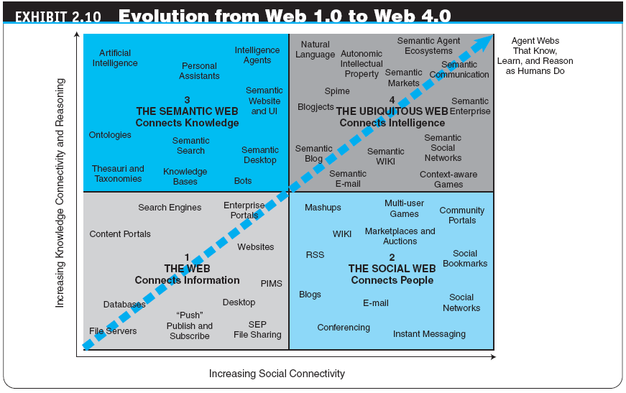

Slide 49
Managerial Issues
Should we use auctions for selling?
Should we barter?
How do we select merchant software?
How can we use Facebook and other social networks in our business?
How shall we start using Web 2.0 tools?
Shall we take part in virtual worlds?
How should we deal with Web 2.0 risks?

Slide 50
Summary
Activities and mechanisms
E-marketplaces and their components
The major types of e-marketplaces
Electronic catalogs, search engines, and shopping carts
Types of auctions and their characteristics
The benefits and limitations of auctions

Slide 51
Summary
Bartering and negotiating
The structure and role of virtual communities
Web 2.0 tools
Social networks as an EC mechanism
Virtual worlds
Web 3.0 and Web 4.0

